Slide 1

Retail Supply Chain & Warehousing Analytics

Slide 2
About Me
C. DIVYA SRI
B. Tech | Fresher
Learning focus: Data Science and SQL
To turn data into meaningful insights and support better, data-driven decisions.
Project role: Individual
LinkedIn : C. DIVYA SRI | LinkedIn
Git hub :

Slide 3
Table of Contents
1.Project Overview
2. Business Scenario
3. Business Objectives
4. Dataset & Database Overview
5. ER Diagram & Database Structure
6. Analysis of the Objectives
7. Overall Key Findings
8. Business Recommendations
9. Conclusion
10. Q&A

Slide 4
Project Overview
Project
Data
Approach
Retail Supply Chain Analytics
Relational analysis using MySQL
6 CSV datasets
11,190 total records across six tables
Database design, data validation, joins, grouping, sorting, and aggregate functions
Project aim: use structured data to understand warehouse ordering, supplier profiles, staff and vehicle activity, and shipment outcomes. The project uses existing records; it does not claim to predict future demand.
C. Divya Sri | Retail Supply Chain Analytics | 4

Slide 5
Business Scenario
A retail supply chain coordinates warehouses, suppliers, purchase orders, staff, vehicles, and shipments. These activities create related records across several tables.
The business challenge is to bring those records together and summarize ordering and delivery activity so that operations can be reviewed consistently.
Warehouse view
Supplier view
Shipment view
Order volumes and purchasing costs
Supplier categories and reliability ratings
Status, attempts, distance, and transit duration
C. Divya Sri | Retail Supply Chain Analytics | 5

Slide 6
Business Objectives
01 Purchase Order Demand
Compare orders across warehouses, suppliers, supplier categories, priorities, dates, and product categories.
02 Warehouse Ordering Behaviour
Compare order counts and total order costs across warehouses, regions, warehouse types, and time.
03 Shipment Performance
Examine shipment status and transit duration; compare outcomes by supplier, warehouse, and time.
04 Staff & Vehicle Performance
Understand shipment workload by staff, staff ratings, vehicle type, vehicle usage, and transit duration.
05 Shipment Problems
Investigate multiple shipment attempts, status patterns, and possible differences by warehouse or supplier.
C. Divya Sri | Retail Supply Chain Analytics | 6

Slide 7
Dataset & Database Overview
Table | Rows | Columns | Purpose
warehouses | 30 | 7 | Warehouse location, type, region, capacity
suppliers | 150 | 6 | Supplier category and reliability rating
staff | 120 | 6 | Staff details, employment type, active status
vehicles | 90 | 7 | Vehicle type, payload, depot, service and active status
purchase_orders | 5,000 | 8 | Order date, warehouse, supplier, category, priority, quantity, cost
shipments | 5,800 | 10 | Shipment links, staff/vehicle, dates, status, attempts, distance, duration
Total: 11,190 records. Primary keys identify individual rows; foreign keys connect related records.
C. Divya Sri | Retail Supply Chain Analytics | 7

Slide 8
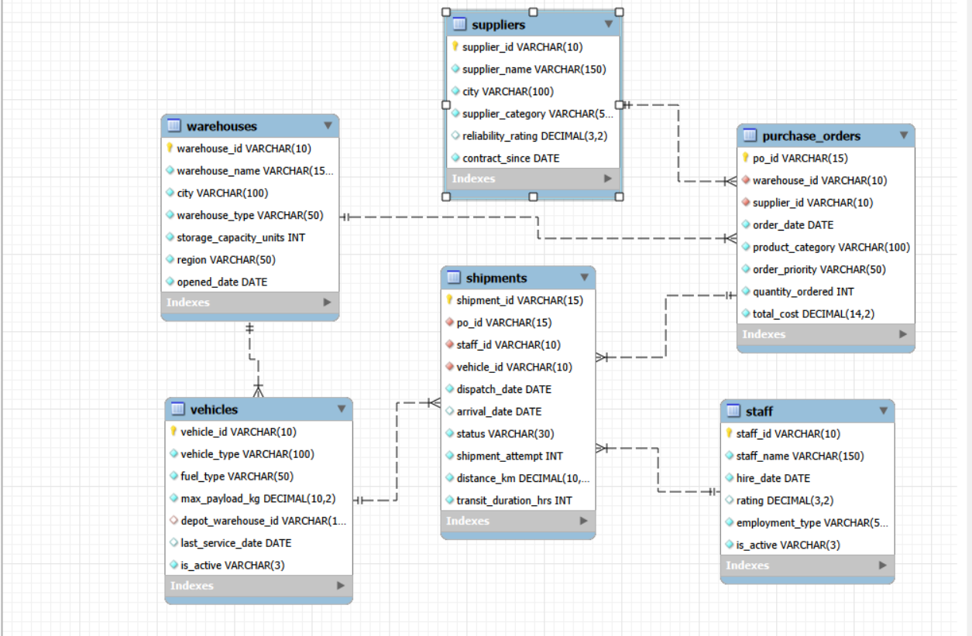
ER Diagram & Database Structure
Simplified relationships based on the table keys
C. Divya Sri | Retail Supply Chain Analytics | 8

Slide 9
Analysis of the Objectives
Purchase Order Demand Analysis
Summary:
This objective analyses purchase-order demand across product categories, suppliers, warehouses, order priorities, and time periods. It also examines purchase-order costs to understand purchasing patterns and identify areas of high demand and spending.
Analysis covered:
Analysed purchase-order volume across different product categories.
Examined suppliers based on the number of purchase orders received.
Compared purchase-order demand across warehouses.
Evaluated order volume and quantity across different priority levels.
Analysed monthly purchase-order trends to understand demand changes over time.
Compared total purchase-order costs across product categories to identify spending patterns.
8
C. Divya Sri | Retail Supply Chain Analytics | 9

Slide 10
Warehouse Ordering Behaviour
Summary:
This objective evaluates warehouse ordering behaviour by comparing purchase-order volume, total procurement cost, region, warehouse type, and average order quantity. It helps understand differences in warehouse purchasing activity and supports better procurement planning.
Analysis covered:
Compared the number of purchase orders placed by each warehouse.
Analysed total purchase-order cost across warehouses.
Examined regional differences in purchase-order activity.
Compared ordering patterns across different warehouse types.
Evaluated average order quantity for each warehouse.
Analysed monthly ordering trends across warehouses to understand changes in purchasing activity.
8
C. Divya Sri | Retail Supply Chain Analytics | 10

Slide 11
Shipment Performance Analysis
Summary:
This objective evaluates shipment performance by examining shipment status, transit duration, supplier-related outcomes, warehouse-related delays, and shipment trends over time. It helps identify delivery patterns and areas that may require operational improvement.
Analysis covered:
Analysed the distribution of delivered, delayed, damaged, and in-transit shipments.
Compared suppliers based on delayed and damaged shipment records.
Calculated average shipment transit duration.
Identified warehouses with higher numbers of delayed shipments.
Examined monthly shipment trends by status.
Compared average transit duration across different shipment statuses.
8
C. Divya Sri | Retail Supply Chain Analytics | 11

Slide 12
Staff and Vehicle Performance
Summary:
This objective analyses staff workload and vehicle utilization by examining shipment assignments, transit duration, shipment outcomes, and vehicle types. It helps understand logistics resource usage and identify operational patterns for further investigation.
Analysis covered:
Compared the number of shipments handled by each staff member.
Analysed average transit duration for shipments handled by staff members.
Examined shipment outcomes associated with each staff member.
Compared shipment usage across different vehicle types.
Evaluated average transit duration across vehicle types.
Analysed delayed and damaged shipment counts by vehicle type.
8
C. Divya Sri | Retail Supply Chain Analytics | 12

Slide 13
Shipment Problems Analysis
Summary:
This objective investigates shipment-related problems by examining repeated shipment attempts, attempt-number patterns, shipment statuses, and records associated with warehouses and suppliers. It also examines missing arrival dates to identify records that may require further review.
Analysis covered:
Counted shipment records with more than one recorded attempt.
Analysed the distribution of shipment records by attempt number.
Examined shipment statuses among records with repeated attempts.
Compared warehouses based on repeated-attempt shipment records.
Compared suppliers based on repeated-attempt shipment records.
Analysed missing arrival dates by shipment status to identify records requiring review.
8
C. Divya Sri | Retail Supply Chain Analytics | 13

Slide 14
Basic Analysis & Data Exploration
Sprint 3: baseline checks before objective-based analysis
Dataset size
Product mix
Count warehouses, purchase orders, and shipment records.
List product categories and count purchase orders in each category.
Staff & fleet
Order value
Count staff by active status and vehicles by vehicle type.
Calculate SUM(total_cost) across purchase orders.
Order quantity
Calculate AVG(quantity_ordered) per purchase-order record.
Data checks also covered row counts, duplicate IDs, and relationship validity.
C. Divya Sri | Retail Supply Chain Analytics | 14

Slide 15
Overall Key Findings
Purchase orders
Shipment records
Recorded order cost
5,000 orders
5,800 shipments
4,093,689,531.08 (currency not specified)
Largest order category
Highest order-count warehouse
Grocery: 1,406 purchase orders
NorthPeak Kochi Distribution Warehouse: 399 purchase orders
Shipment status counts
Repeated-attempt records
Delivered 3,686 | Damaged 964
Delayed 953 | In-Transit 197
1,050 shipment records have attempt number 2
Note: Findings describe this dataset only. They are not proof of causes or future performance.
C. Divya Sri | Retail Supply Chain Analytics | 15

Slide 16
Business Recommendations
Recommendations should be finalized after reviewing actual query results
Warehouse planning
Review warehouses with consistently high order volume or total cost; compare with capacity and region before reallocating work.
Supplier management
Investigate supplier categories or individual suppliers with lower reliability ratings or weaker shipment outcomes.
Shipment monitoring
Track status and transit duration by priority, warehouse, supplier, and date to identify patterns requiring follow-up.
Resource utilization
Review staff workload and vehicle usage together with route distance and shipment outcomes.
Repeated attempts
Inspect repeated-attempt records and statuses to understand whether issues relate to delivery, damage, or process delays.
C. Divya Sri | Retail Supply Chain Analytics | 16

Slide 17
Conclusion
This project demonstrates how MySQL can organize and analyze related retail supply-chain data across six tables.
Using validation checks, joins, grouping, sorting, and aggregate functions, the analysis summarizes purchasing activity and shipment outcomes and highlights areas for further review.
Database skills
SQL skills
Business thinking
Keys, relationships, data validation
COUNT, SUM, AVG, JOIN, GROUP BY
Turn query outputs into review priorities
Next steps: confirm findings in MySQL, add screenshots of result grids, and rehearse the presentation.
C. Divya Sri | Retail Supply Chain Analytics | 17

Slide 18

THANK YOU
C. Divya Sri | Retail Supply Chain Analytics

